Slide 1
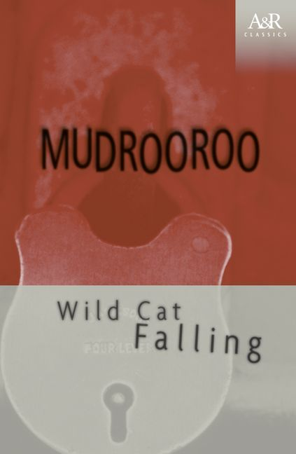
Wild Cat Falling
Mudrooroo (Colin Johnson)

Slide 2
1. Initial Thoughts
What are your initial thoughts about ‘Wild Cat Falling’? Do you like/dislike it? Why/Why not?
What do you believe is the overall tone and message of the story? (Chapt 1)

Slide 3
Wild Cat Falling
First published 1964
Hailed as the first novel by an Aboriginal Australian
Written by Colin Johnson who later changed his name to Mudrooroo Bibbelmun Narogin

Slide 4
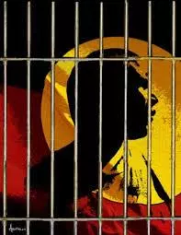
A simple gesture
Wild Cat Falling is the story of an Aboriginal youth, a 'bodgie' of the early sixties who grows up on the ragged outskirts of a country town, falls into petty crime, goes to gaol, and comes out to do battle once more with the society who put him there. Its publication in 1965 marked a unique literary event, for this was the first novel by any writer of Aboriginal blood to be published in Australia. As well, it is a remarkable piece of literature in its own right, expressing the dilemmas and conflicts of the young Aboriginal in modern Australian society with its memorable insight and stylishness.
https://www.harpercollins.com.au/9780207197321/

Slide 5
Structure
Three Parts:
Part One: Release
Part Two: Freedom
Part Three: Return
A series of flashbacks.
What we are reading:
one: Last days in Jail.
**Flashback: Child living with mother and Mr Willy.

Slide 6
What themes are present?
Tip
Ideally, speak of people in very different situations, but where each could benefit from your solution.

Slide 7
Purpose and Audience
What is the purpose of Mudrooroo’s ‘Wild Cat Falling’?
Who is the intended audience?

Slide 8
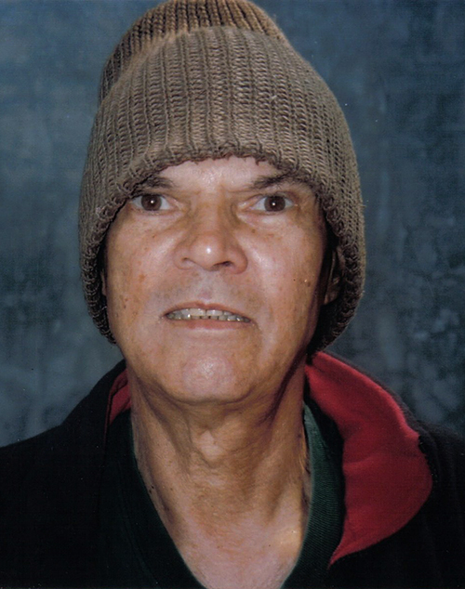
Mudrooroo (Colin Johnson) Identities:
Institutionalised
Indigenous
Bodgie group
Beatnik/ Bohemian
Buddhist
Wild Cat Falling= A novel about identity and identities.

Slide 9
Why it is important
The idea of the ‘first’ novel by an Indigenous person in Australia was part of a watershed in Indigenous issues.
There idea of authenticity seems to be critical for Indigenous writers in general.
“Acknowledged for over two decades as the arbitrator in matters of authentic Aboriginal writing, his was the voice of Indigenous Australia, both at home and abroad.” (Maureen Clark, “Unmasking Mudrooroo”, 48)

Slide 10
Mudrooroo’s criticism of Sally Morgan
She is criticised (along with Glenyse Ward) for writing literature of assimilation and not activism
“In fact with increased education and job opportunities there is an impetus towards a merging into the majority culture, identified here as Anglo-Celtic […] Assimilation, although discredited, still operates through government education and employment policies. New writers such as Sally Morgan and Glenyse Ward do not see themselves as part of an active ongoing movement, but as individuals either searching for their roots or seeking equal opportunity in multicultural Australia” (Writing from the Fringe, 14)
“Sally Morgan’s book is a milepost in Aboriginal literature in that is marks a stage when it is considered O.K. to be Aboriginal as long as you are young, gifted and not very black.” (Writing from the Fringe, 149)
Criticism based on authenticity and the perceived aesthetic assimilation of Morgan’s work

Slide 11
Attitudes towards Indigenous
‘The white Canadian looks at the Indian. The Indian is Other and therefore alien. But the Indian is indigenous and therefore cannot be alien. So the Canadian must be alien. But how can the Canadian be alien within Canada?’ ….
‘A variety of strategies are used by the settler in Canada and Australia to cope with this, ranging from erasing the aboriginal peoples to embracing them, in a process I called indigenisation. This oscillation between erasure and embrace means that there is a constant ambivalence in Australian history, between over-valuing and under-valuing indigeneity’
(Terry Goldie, ‘On Not Being Australian: Mudrooroo and Demidenko’)

Slide 12
Let’s look at two possible responses

Slide 13
“It has become possible to regard Mudrooroo’s work as the creation of the clever literary trickster who has written himself into a narrative of Aboriginal belonging that is as much a fabrication as the characters who inhabit the pages of his books.” (Maureen Clark, “Unmasking Mudrooroo”, 48)

Slide 14
2) “Mudrooroo […] had claimed, or assumed, his Aboriginality very early, and certainly not at a time when it could have been to his advantage to do so. In doing so, it could be said, he was only following the lead of the white authorities who assumed he was Aboriginal and had treated him accordingly. […] there seemed, to some, to be reason to suspect that the dominant white culture had chosen to see Mudrooroo as Aboriginal when it suited it, and was now choosing to see and define him otherwise.” (David Brooks, The Sons of Clovis, 48)

Slide 15
ARTICLE FROM THE AGE:
LINK HERE

Slide 16
After considering the responses
Do you believe Mudrooroo (Colin Johnson) has accurately depicted his life struggles in chapter 1 of ‘Wild Cats Falling’?
If so, how has he ensured he has done this? Ie- setting, themes, characterisation, tone- provide example from the text to support your answer.

Slide 17
Critical Reflection
Reflect on ‘Wild Cat Falling’ by Colin Johnson.
Analyse the effectiveness of his portrayal of assimilation and misplacement in Australia. How does he communicate his experiences and thoughts on these matters?(techniques) Does he do it well?
Aim for ¾-1 page
Write in test conditions.

